Slide 1
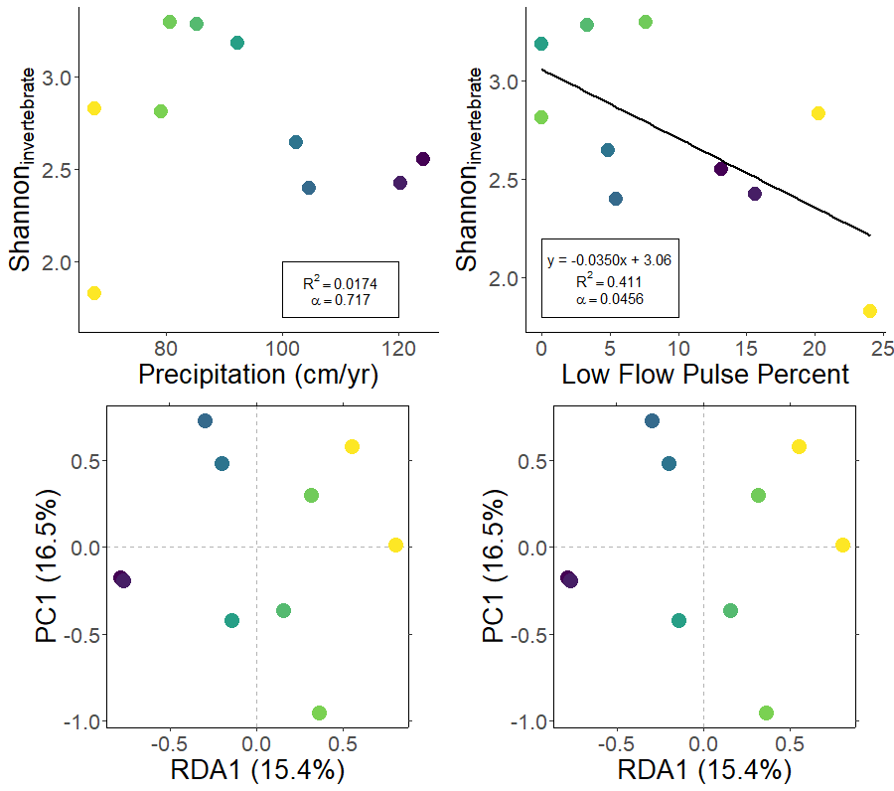
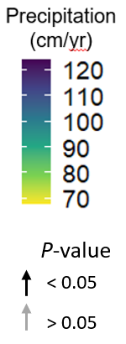
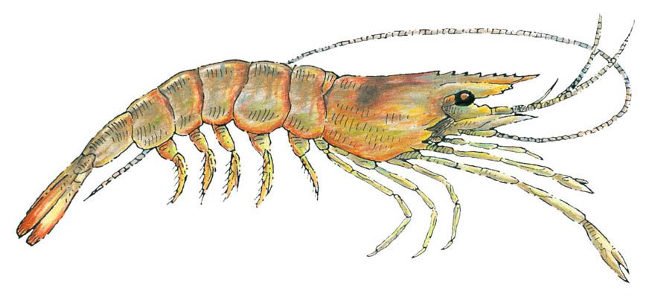
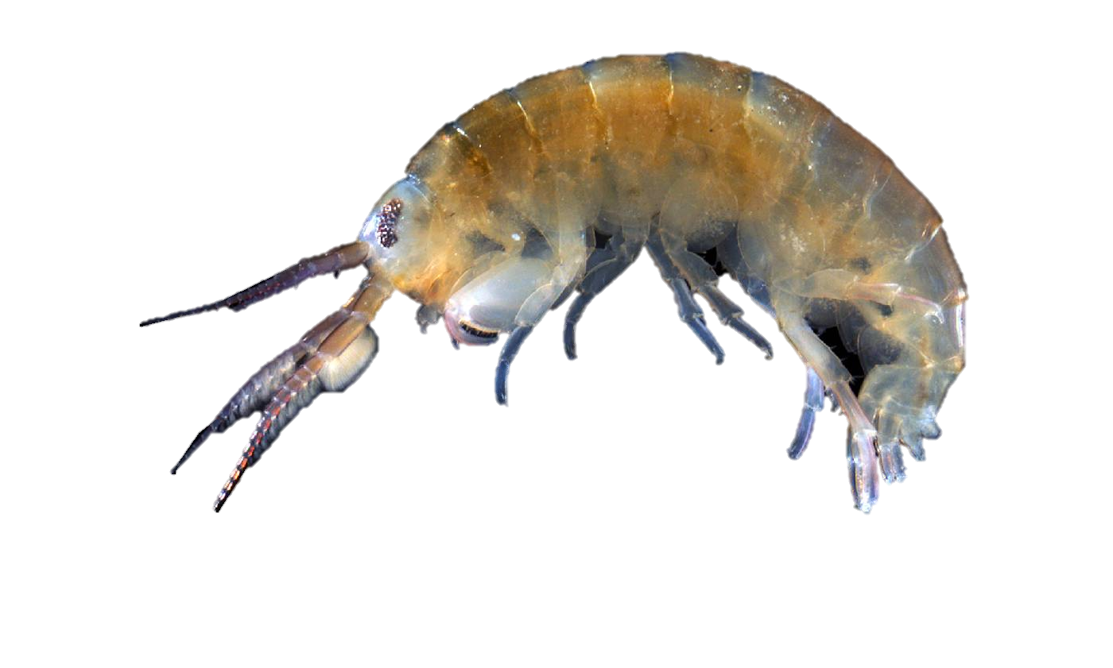
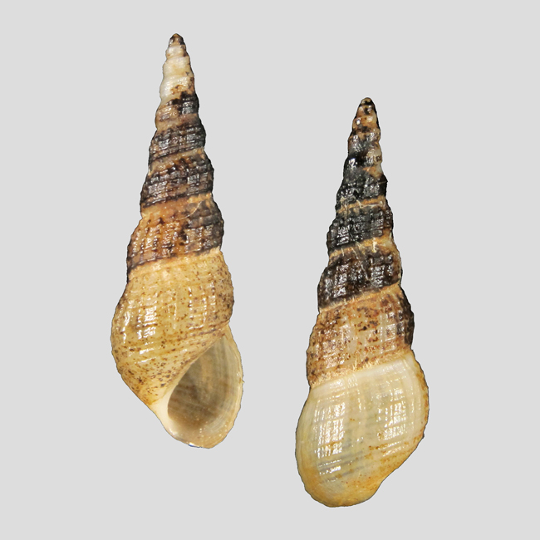
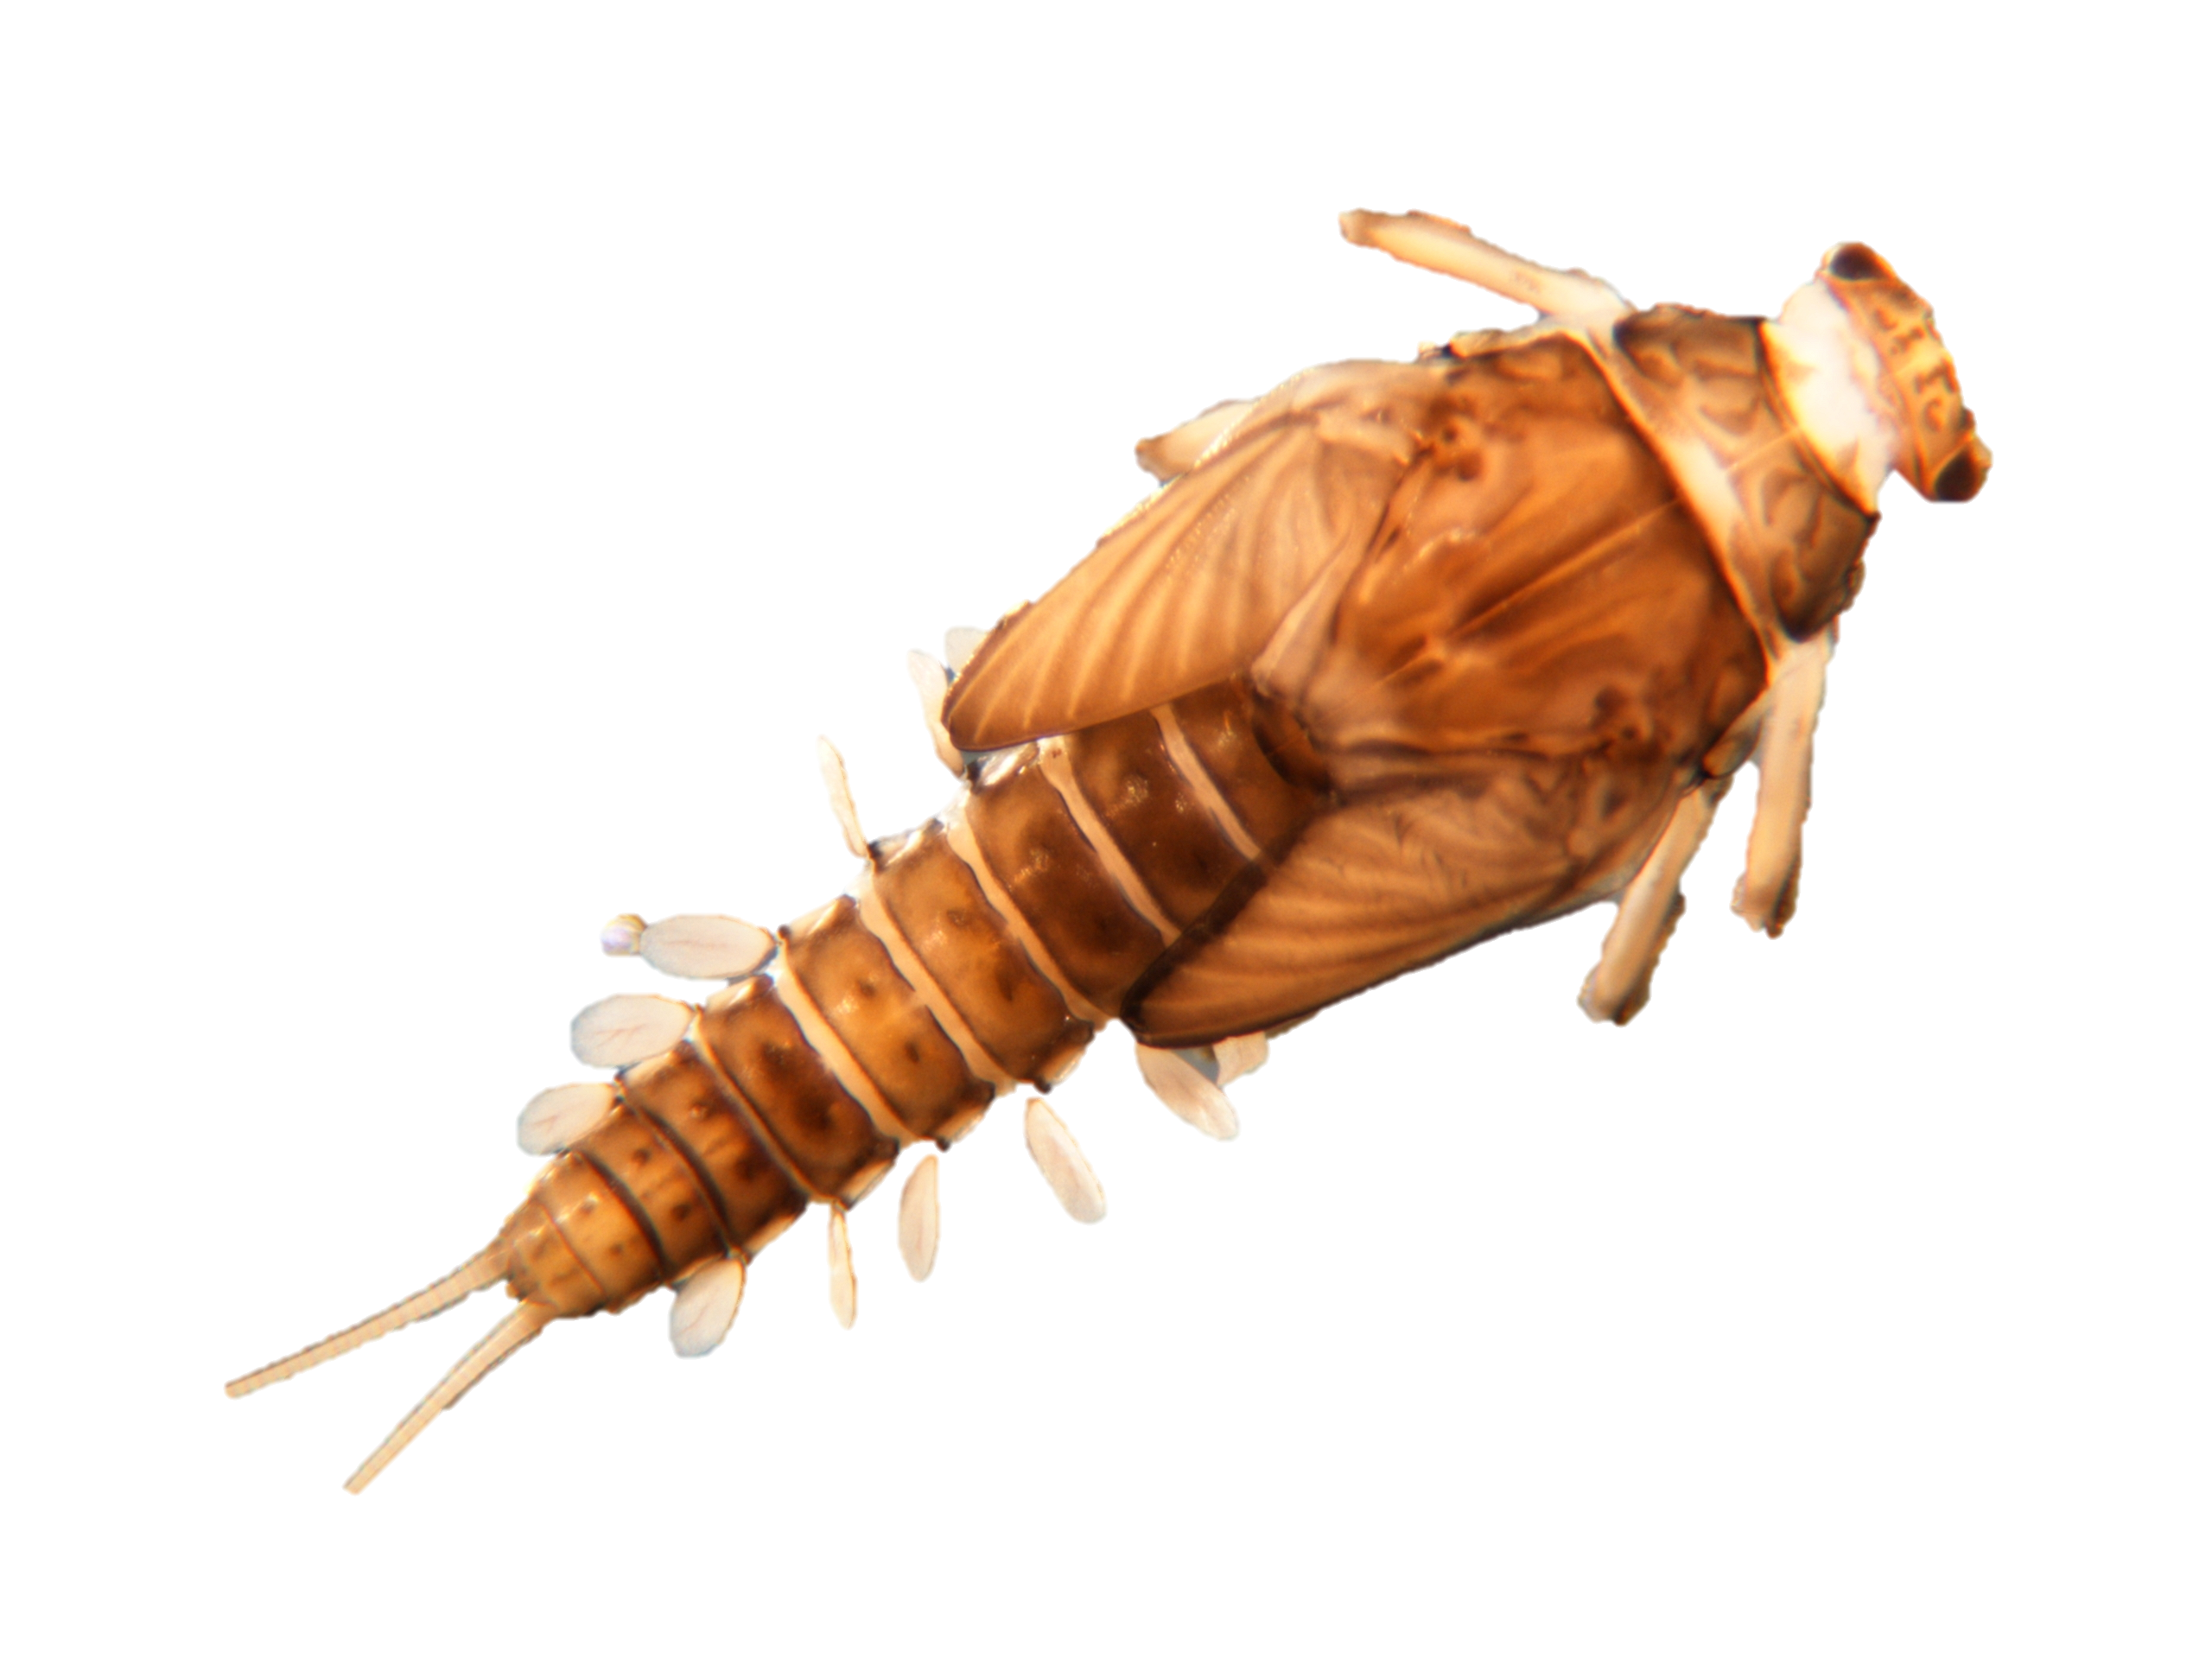
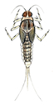
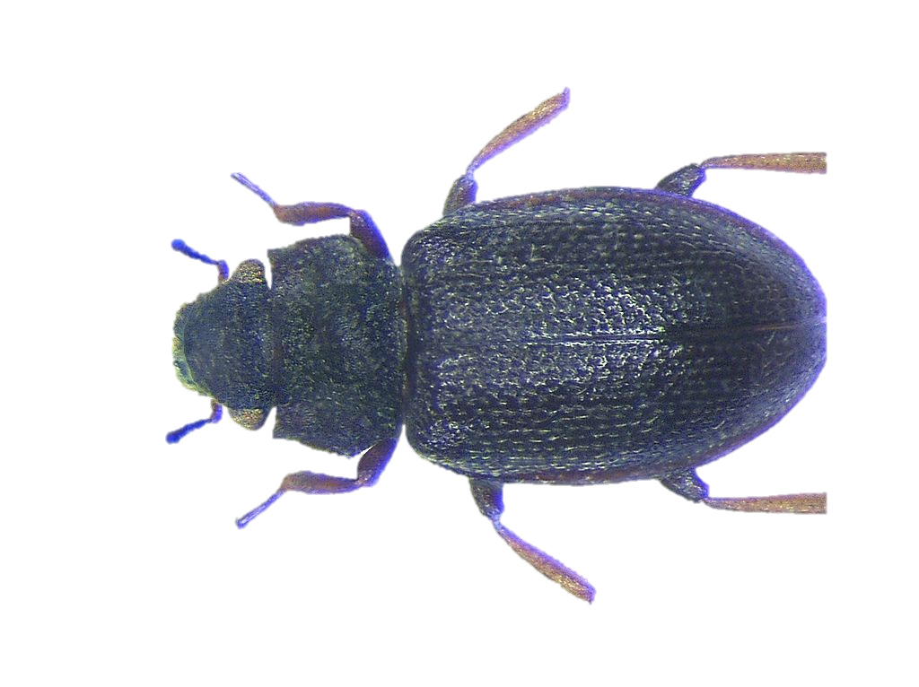
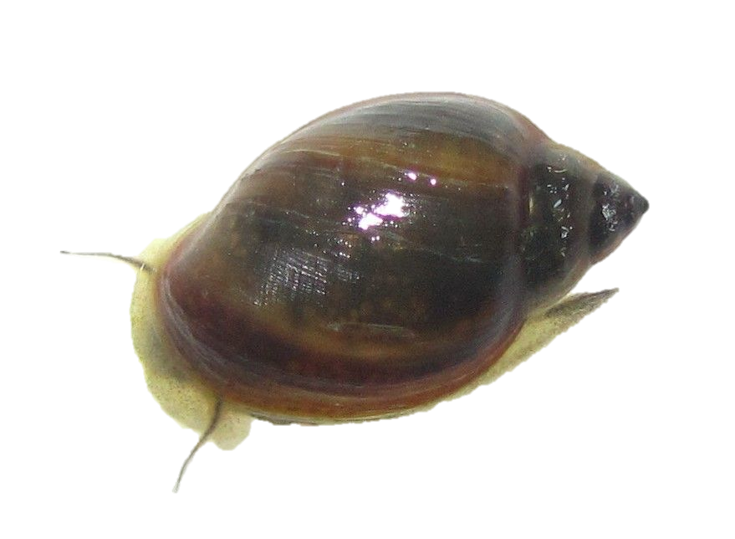
a
b
c
Low Flow Pulse %
d
Cheumatopsyche
Canopy
NH₄⁺
Palaemonetes
Precipitation
Conductivity
Hyalella
Melanoides
Plauditus
Hydraena
Caenis
Physa
Flash Index
Rosgen Index
Notes:
Figure 4: Macroinvertebrate Shannon diversity plotted against (A) annual precipitation (cm/yr) and (B) Low Flow Pulse Percent. (C & D) Fish community ordinations using Hellinger transformation and redundancy analysis. Axes labels contain proportion of the variance explained as a percentage. Dots represent sites with color determined by annual precipitation. Arrows represent fitted vectors for (C) environmental predictors and (D) species which can be visually interpreted based on their direction. Black arrows indicate statistically significant (p-value < 0.05) correlations. Only significant species vectors were plotted to improve figure clarity.

